Slide 1
IST 210 Organization of Data Introduction to Database Penn State Abington
Dr. S. Gokhan Ozden
gokhan@psu.edu

Slide 2
What is Data and Information?
Data is nothing but raw facts which is not processed.
We need to process this data to derive information which we require for different purposes.
Data must be formatted for storage, processing and retrieval.

Slide 3
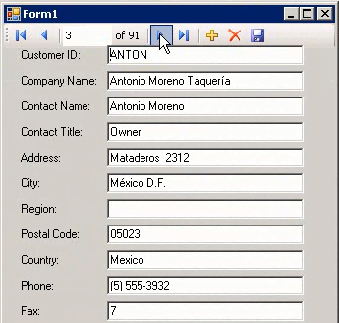
Data and Information Example
Data
Information
Knowledge Base
Process
Data
Process
Information
CustomerID | CompanyName | ContactName | ContactTitle | Address | Phone | Fax
ALFKI | Alfreds Futterkiste | Maria Anders | Sales Representative | Obere Str. 57 Berlin 12209 Germany | 030-0074321 | 030-0076545
ANATR | Ana Trujillo Emparedados y helados | Ana Trujillo | Owner | Avda. de la Constitución 2222 México D.F. 5021 Mexico | (5) 555-4729 | (5) 555-3745
ANTON | Antonio Moreno Taquería | Antonio Moreno | Owner | Mataderos 2312 México D.F. 5023 Mexico | (5) 555-3932 | NULL
AROUT | Around the Horn | Thomas Hardy | Sales Representative | 120 Hanover Sq. London WA1 1DP UK | (171) 555-7788 | (171) 555-6750
BERGS | Berglunds snabbköp | Christina Berglund | Order Administrator | Berguvsvägen 8 Luleå S-958 22 Sweden | 0921-12 34 65 | 0921-12 34 67
Process Information
Storage and Retreival
Information Store

Slide 4
What is a Database?
A database is a shared structured collection of
Raw data and
Metadata – Data about data which is used to manage this raw data and summarize the structure of this data
Meta data describes the attributes and relationship among the raw data.
Ex - Meta data for a file system would be the Properties of that file which describes what type of file it is, when it was created, author etc.

Slide 5
Why Database
Why not file system?
File systems needs to be logically organized for ease of access which becomes increasingly difficult.
Logical means that the information that is stored in these different files and files themselves is seen as a single data store to the end user.
Data within these files are not easy to search and update
Database on the other hand is a logical arrangement of data where you can easily specify relationships among data and easily identify data.

Slide 6
Database Architecture
The three main schema of the database levels proposed by ANSI/SPARC (American National Standards Institute/Standards Planning and Requirements Committee)
External level
End user
End user
Conceptual or Logical level
Conceptual or Logical Design
Physical level
Internal Schema
Database

Slide 7
Database Architecture
External or view level – The way users perceive the data. It is customized to user needs.
Conceptual and Logical level – Map of concepts and their relationships. Complete view of the data requirements of the organization, independent of any storage consideration.
Ex: ER diagram (Conceptual) and Relational Schema (Logical)
Internal level – This level deals with how data is organized as files, Data compression, indexing, encryption and space allocation.

Slide 8
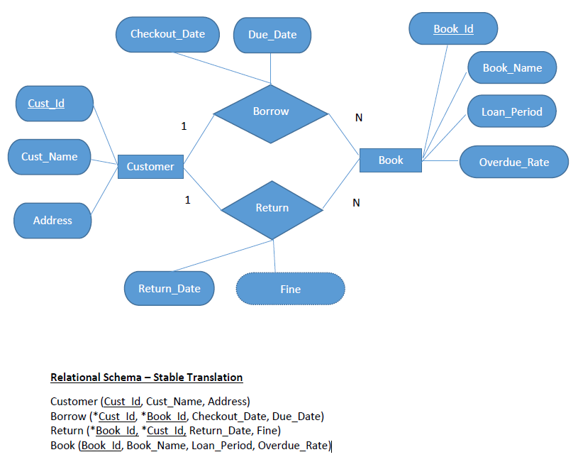
Conceptual Design Example

Slide 9
Data Independence
Data Independence – It is the ability to change scheme in one level without affecting schema in a higher level.
Logical Independence – It is the ability to modify at concept level without changing anything at external level.
Physical Independence – It is the ability of modifying the internal schema without having to change conceptual or external level.

Slide 10
Database Management Systems (DBMS)
It’s a software program which allows information in the database to managed easily and efficiently.
User Interface
Database Management System
Database
Customers
Employees
Orders
Suppliers
Shippers
End User

Slide 11
DBMS Functions
Security – Storing sensitive data securely.
Retrieval – Ability to retrieve any specific data.
Data sharing – Ability to share data with other sources.
Concurrency – DBMS uses sophisticated algorithms that enable multiple users to access the database at the same time.

Slide 12
DBMS Functions (cont’d)
Data description (Metadata) – A data dictionary that stores definition of the data elements and their relationships.
Integrity – Database structure and rules improve the integrity of the data which minimizes data redundancy and inconsistency.
Backup and Recovery – Processes to back up the data and recover data if a problem occurs to ensure data safety and integrity.

Slide 13
ACID Principle
A database has four properties that certify reliability in all transactions
Atomicity – A database follows the “all or nothing” rule. So, when a database processes a transaction, the whole thing either succeeds completely or fails completely.
Consistent – All transactions have to follow all rules to ensure that invalid data is not added to the database.

Slide 14
ACID Principle
Isolation – Ensures that all transactions are independent so it doesn’t interfere with each other.
Durability – Ensures a completed transaction to persist, even if there is a power loss or if the system crashes.

Slide 15
Classification of Database
Database can be classified based on the number of users, data model, how the database is distributed or organized and type of data stored in them
Database
User
Single User
Multi-User
Location
Centralized
Desktop User
Workgroup
Enterprise
Distributed

Slide 16
Classification of Database (cont’d)
Database
Data Specific
General Purpose
Usage Type
Analytical
Discipline specific
Operational
Online Transactional Processing (OLTP)
Decision Making
Structure Based
Unstructured
Structured
Raw Data such scanned files
Formatted Data
Extensible Markup Language (XML)
Online Analytical Processing (OLAP)

Slide 17
Database Models
Based on the data model database can be classified into:
Flat File Model
Hierarchical Model
Network Model
Object Oriented Model
Relational Model
Object-Relational Model (Hybrid)

Slide 18
Flat File Model
It is similar to a spreadsheet where all the information is contained in one file
CustomerID | CompanyName | ContactName | ContactTitle | Address | Phone | Fax
ALFKI | Alfreds Futterkiste | Maria Anders | Sales Representative | Obere Str. 57 Berlin 12209 Germany | 030-0074321 | 030-0076545
ANATR | Ana Trujillo Emparedados y helados | Ana Trujillo | Owner | Avda. de la Constitución 2222 México D.F. 5021 Mexico | (5) 555-4729 | (5) 555-3745
ANTON | Antonio Moreno Taquería | Antonio Moreno | Owner | Mataderos 2312 México D.F. 5023 Mexico | (5) 555-3932 | NULL
AROUT | Around the Horn | Thomas Hardy | Sales Representative | 120 Hanover Sq. London WA1 1DP UK | (171) 555-7788 | (171) 555-6750
BERGS | Berglunds snabbköp | Christina Berglund | Order Administrator | Berguvsvägen 8 Luleå S-958 22 Sweden | 0921-12 34 65 | 0921-12 34 67

Slide 19
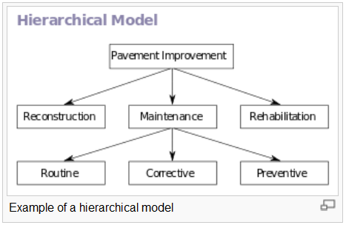
Hierarchical Model
Tree-like structure
Each parent can have
many children
Each child has only
parent
One-to-many relationship
Was popular during the time of mainframe computers.
SOURCE: wikipedia.org

Slide 20
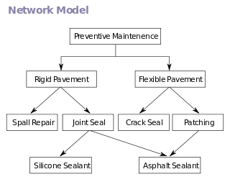
Network Model
Similar to hierarchical database except children can have many parents
Many to many relationship
SOURCE: wikipedia.org

Slide 21
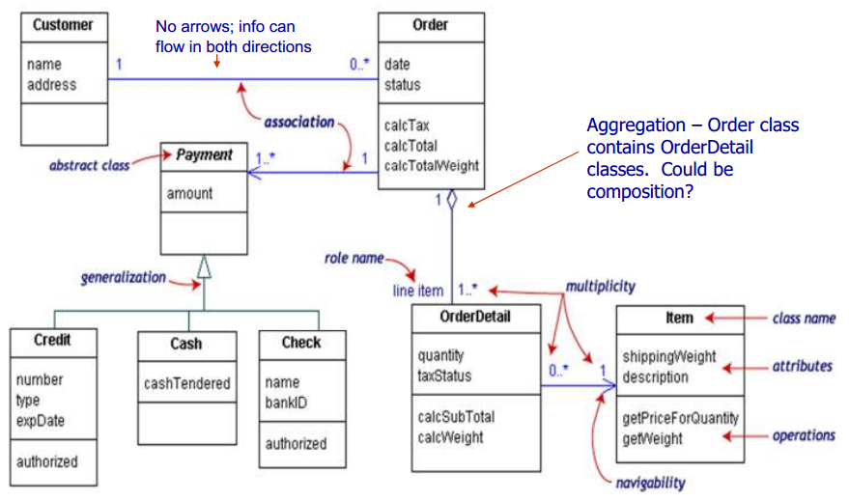
Object Oriented Model
Information is represented in terms of objects
Any object oriented programming uses this model to create class diagrams using UML (Unified Modelling Language)
SOURCE: StackExchange.com

Slide 22
Relational Model
It is an organization of data into one or more tables (relations) containing columns and rows with a unique identifier for each row.
Invented by E.F. Codd in 1970
Definitions:
Tables – A table has rows and columns. It is expressed as relations in Relational database model
Tuple – It is a single row of a table.
Attribute – It refers to column definition which defines what type of data is stored for ex: integer or decimal
Relation schema – It describes the table name, attributes and column names.
Relation Key – Each row has a unique identifier which contains one or more attributes.
Relation instance – One row of a table.

Slide 23
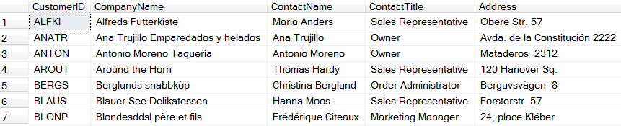
Example Relational Database Model
Attribute
Relation Name
Customer
Tuple

Slide 24
Structured Query Language (SQL)
DBMS allows data access using a query language known as Structured Query Language (SQL)
SQL is a standard programming language that can categorized into:
Data Definition Language (DDL) – This includes query language used for creation, modification and deleting of database objects like tables, columns, indexes, users etc.
Data Manipulation Language (DML) – This includes language which facilitates selecting, inserting, deleting and updating data in one or more tables.

Slide 25
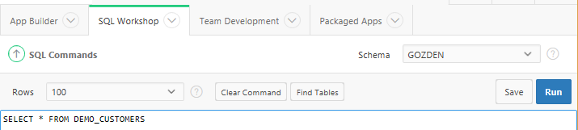
SQL Commands
Launch APEX
Go to SQL Workshop->SQL Commands
Type SELECT * FROM DEMO_CUSTOMERS
Click Run Button

Slide 26
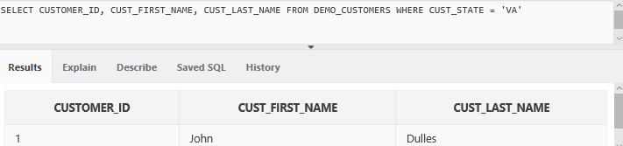
SQL Example (cont’d)
Table Name
Attribute List
Filter (Where Clause)
Result Set
String values are enclosed in single quotes and they are case-sensitive

Slide 27
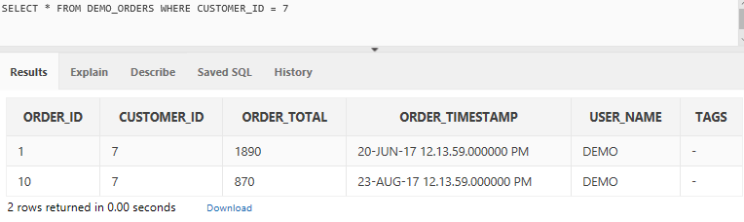
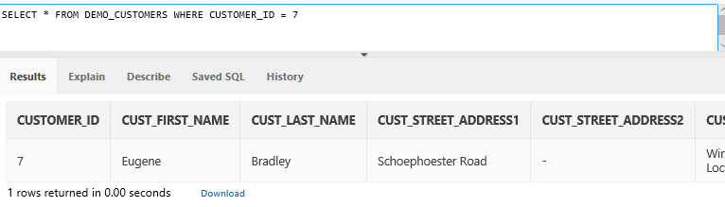
SQL Example (cont’d)
Here is an example of two queries executed together. This is also an example of how Orders and Customers tables are related.
Here they are related by Customer_ID column.
Both these tables have Customer_ID which related them
As you can see here it is a one-to-many relationship

Slide 28
Exercise
Let’s see some basic SQL queries in action to get some initial familiarity with the subject.
We will now go to W3Schools tutorial
http://www.w3schools.com/sql/sql_distinct.asp

Slide 29
Database Users
Database administrators or DBA manages all activities to ensure that the database is functioning properly.
System administrators oversees the database system’s general functions.
Database designers are the architects of the database structure.
System analysts and programmers design and implement the application programs which enables the database to be user friendly.
End users are the users like, sales clerks or managers of an organization, of the database.

Slide 30
Relational Database
Mysql – www.mysql.org
Open source, quite powerful
PostgreSQL – www.postgresql.org
Open source, powerful
Microsoft Access –
Simple system, lots of nice GUI wrappers
Commercial systems –
Oracle 10g (www.oracle.com)
SQL Server 2014 (www.microsoft.com/sql)
DB2 (www.ibm.com/db2)

Slide 31
Covered so far..
Data and information
Database
Why we need a Database?
Database Architecture
Database functions
ACID Principle
Classifications of Database
SQL

Slide 32
Next class
Relational Algebra and Normalization

